Slide 1

MST PRACTISE PROJECT 1 EDA ON HR ANALYTICS
BY
VIKASH KUMAR DIWAKAR
AI/ML INTERN, MST

Slide 2
Why analyse the HR analytics?
1.Cost Management
Hiring new employees is expensive. It involves recruitment costs, onboarding, and training.
2. Employee Retention
Understanding why employees leave helps in identifying patterns (e.g., high attrition in specific departments or job roles).
3. Strategic Planning
Analyzing attrition rates aids in effective workforce planning and ensures the organization has the right talent at the right time.

Slide 3
Introduction
Human Resource (HR) analytics, also known as people analytics, workforce analytics, or talent analytics, involves applying analytical processes to HR data to improve employee performance and achieve better business outcomes. By leveraging data and analytical techniques, HR professionals can gain insights into various aspects of workforce management, such as recruitment, retention, employee engagement, and performance.

Slide 4
Problem Statement
Attrition in HR :Attrition in human resources refers to the gradual loss of employees overtime. In general, relatively high attrition is problematic for companies.
Attrition affecting Companies :A major problem in high employee attrition is its cost to an organization. Job postings, hiring processes, paperwork, and new hire training are some of the common expenses of losing employees and replacing them.

Slide 5




OVERVIEW OF ANALYSIS
Data Cleaning
Data Exploration
Predictive Modeling
Understand the structure of the dataset and clean data before analysis
Uncover initial patterns, characteristics, and points of interest using visual exploration
Formulate a statistical model to forecast an outcome using relevant predictors

Slide 6
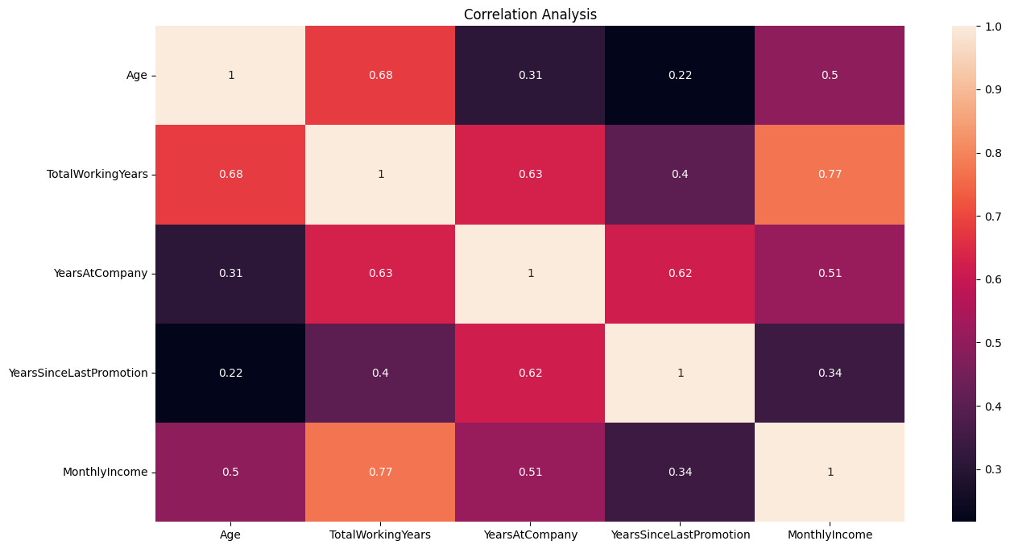
Correlation Heatmap
There is a huge positive correlation between TotalWorkingYears and Monthly Income.
Positive relation between Age and ToatalWorkingYears.

Slide 7
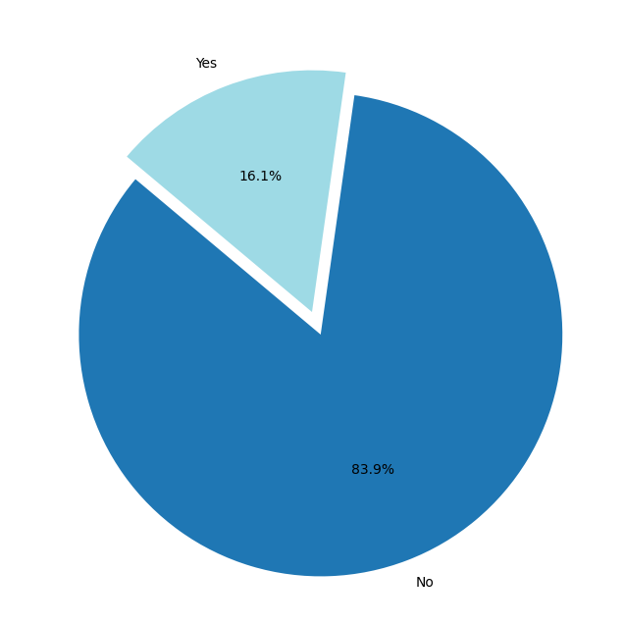
Attirition
We observed that 16.1% of employee attirition and 83.9% employee retain their job.

Slide 8
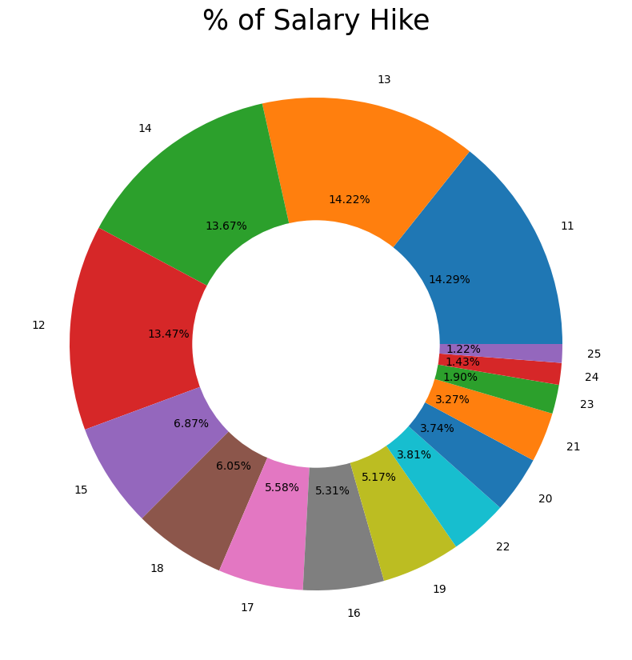
% Salary Hike
We observed that 14.29% was maximum salary hike and lowest salary hike was 1.22% for 25 employees which was maximum.

Slide 9
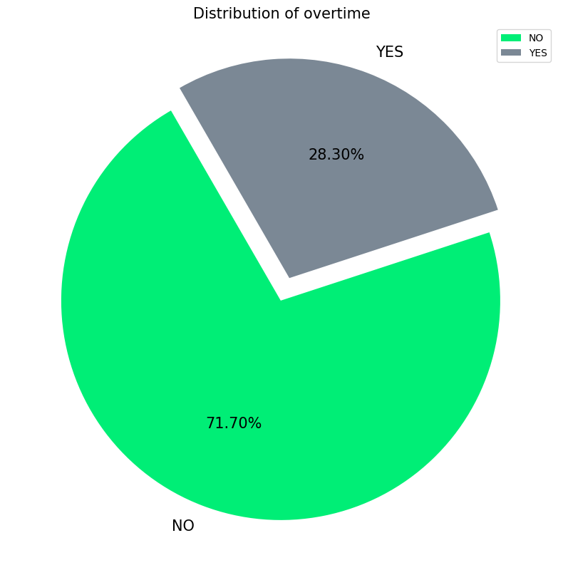
Overtime
We observed that only 28.3% employees did overtime in company.

Slide 10
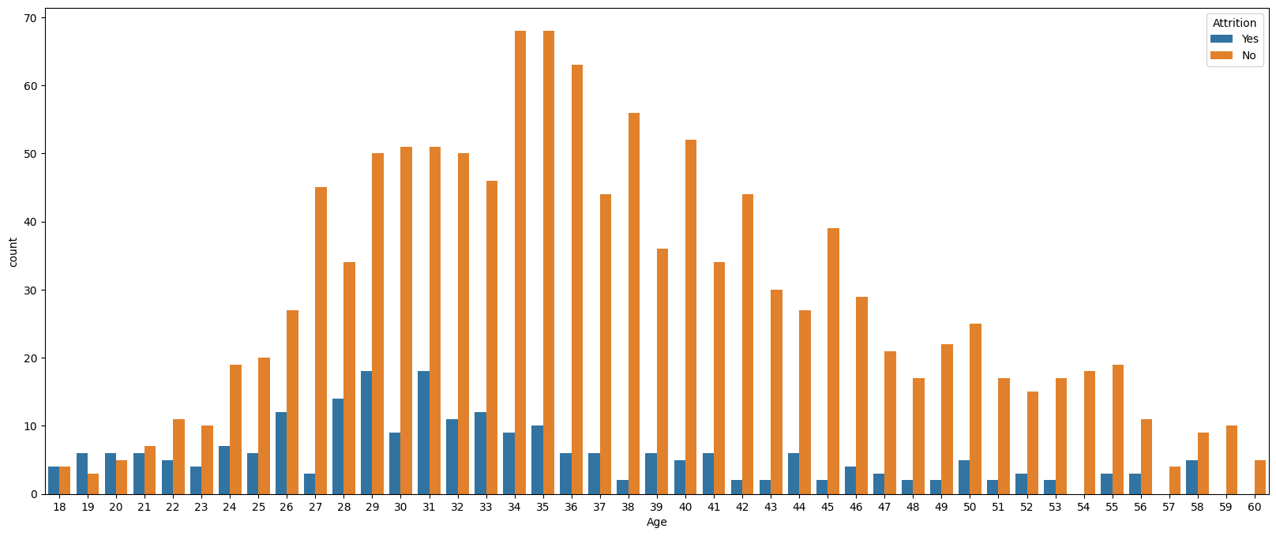
Age Vs Attirition
We observed that employees of Age 18-21 the chances of attrition are very much high and it’s a point of concern and company need to have a look upon it.

Slide 11
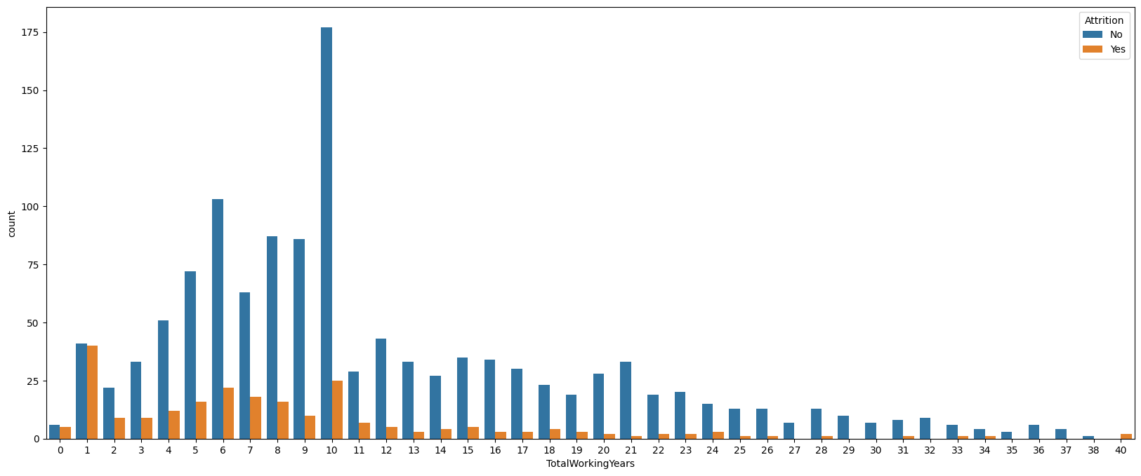
Total working years Vs Attirition
We observed that employees who are freshers tends to leave job.

Slide 12
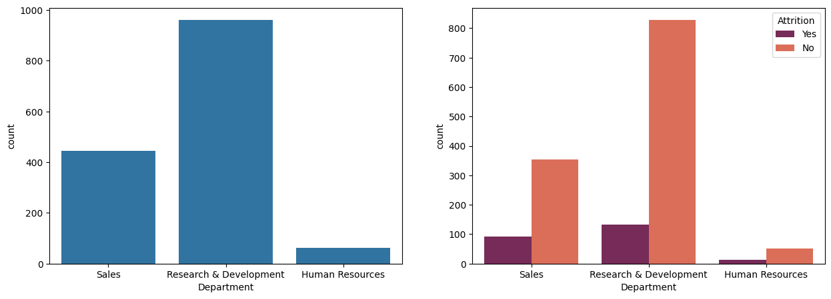
Department Vs Attirition
We observed that there is no relation between department and attirition.

Slide 13
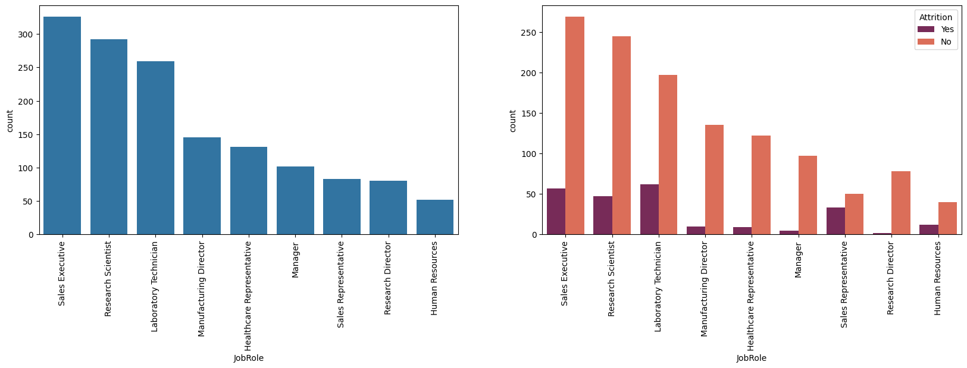
Job-Role Vs Attirition
There is a Major concern in Sales Representative role because the percentage of attirition is very much high and it’s a point of concern.

Slide 14
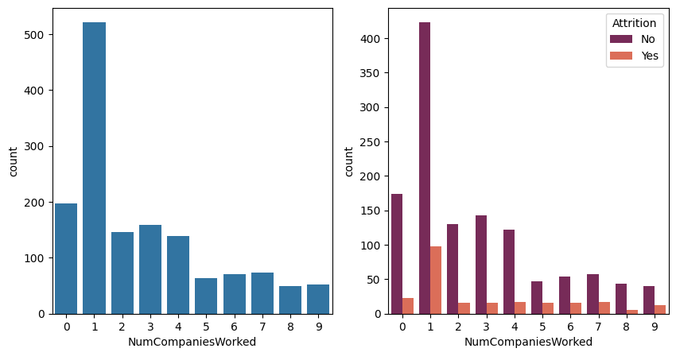
No. Of Campanies Worked Vs Attirition
There is concern in employee who have worked in 1 company tend to leave job earlier.

Slide 15
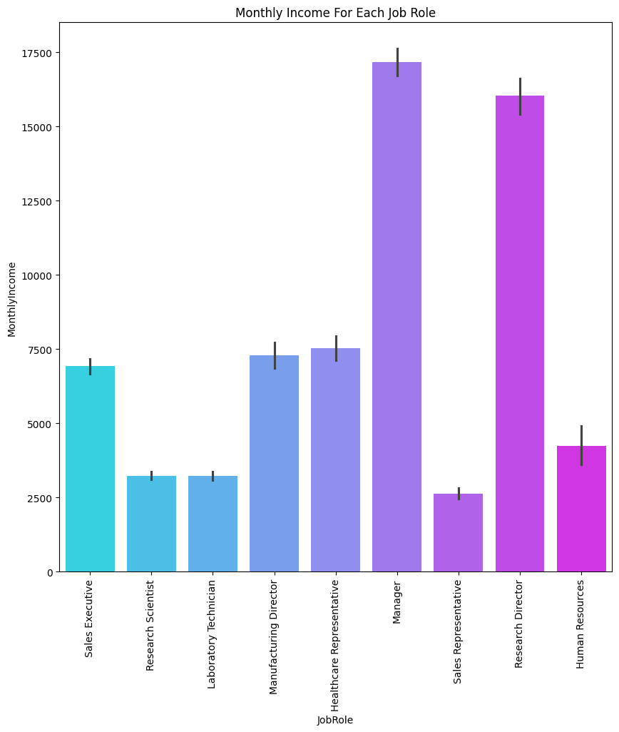
Job-Role Vs Monthly Income
We can see that Managers and Research Director Receives highest salary of almost ~$175,000 whereas Sales Representatives gets lowest salary around ~$25,000.

Slide 16
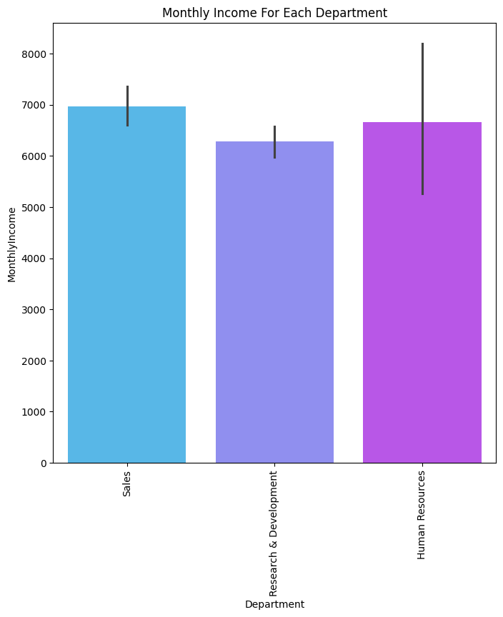
Department Vs Monthly Income
Almost all departments make equal salary.

Slide 17
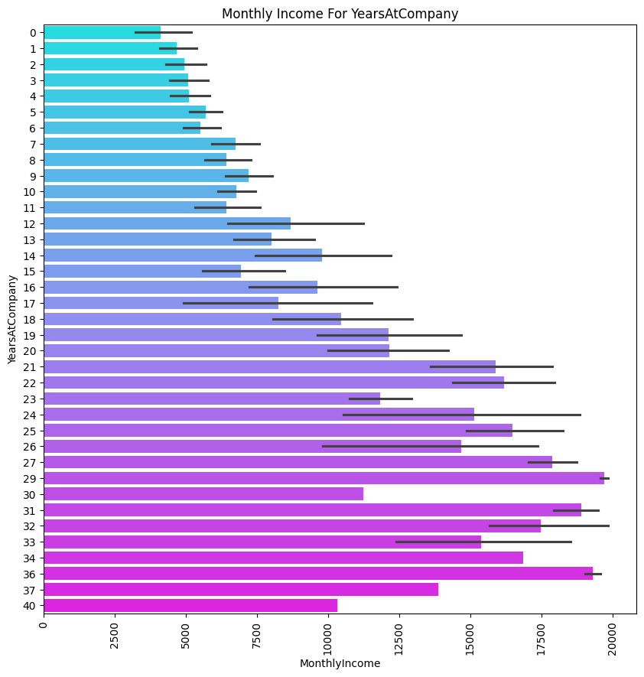
Years at Company Vs Monthly Income
Employees who are there in company for more than 20 years receives salary above ~$125,000. But there is an exception of employee working for 40 years receives lower salary when compared to others.

Slide 18
Challenges
Reading the dataset and comprehending the problem statement.
Examining the business KPIs and devising a solution to the problem.
Handling the error, duplicate and null values in the dataset.
Designing multiple visualizations to summarize the information in the dataset and successfully communicate the results and trends to the reader.

Slide 19
Conclusion
The Overall attrition of the company is around 16%.
Fresher employee tends to leave job earliest.
There is a Major concern in Sales Representative role because the percentage of attirition is very much high and it’s a point of concern.
There is concern in employee who have worked in 1 company tend to leave job earlier.
We can see that Managers and Research Director Receives highest salary of almost ~$175,000 whereas Sales Representatives gets lowest salary around ~$25,000.
Employees who are there in company for more than 20 years receives salary above ~$125,000. But there is an exception of employee working for 40 years receives lower salary when compared to others.

Slide 20

.
.

